Slide 1

Prevent Data Loss Enhancement
November 2016
SPM Technical Infrastructure

Slide 2
Overview
Background
Problem Statement
Problem Statement Examples
Solutions
Proposed Business Solution
Proposed Business Solution Examples
Questions

Slide 3
Problem Statement
The use of any of the browser back, refresh or close buttons in Cúram may lead to loss of data (e.g. a form is being filled out). We need to ensure that the system behaves in a consistent manner if a citizen or user clicks on these browser buttons.
RTC Ticket 168582 ”R1 - Prevent Loss of Data: Improve the Curam Application (both internal and external) handling of the Browser Back, Refresh and Close actions with a browser standard confirmation dialog”
City of New York - Department of Information Technology (DoITT) (7126789)
Alberta HRE (938221)
North Carolina - Dept of Health and Human Services (8530493)
Singapore, MSF - Singapore (843493)

Slide 4
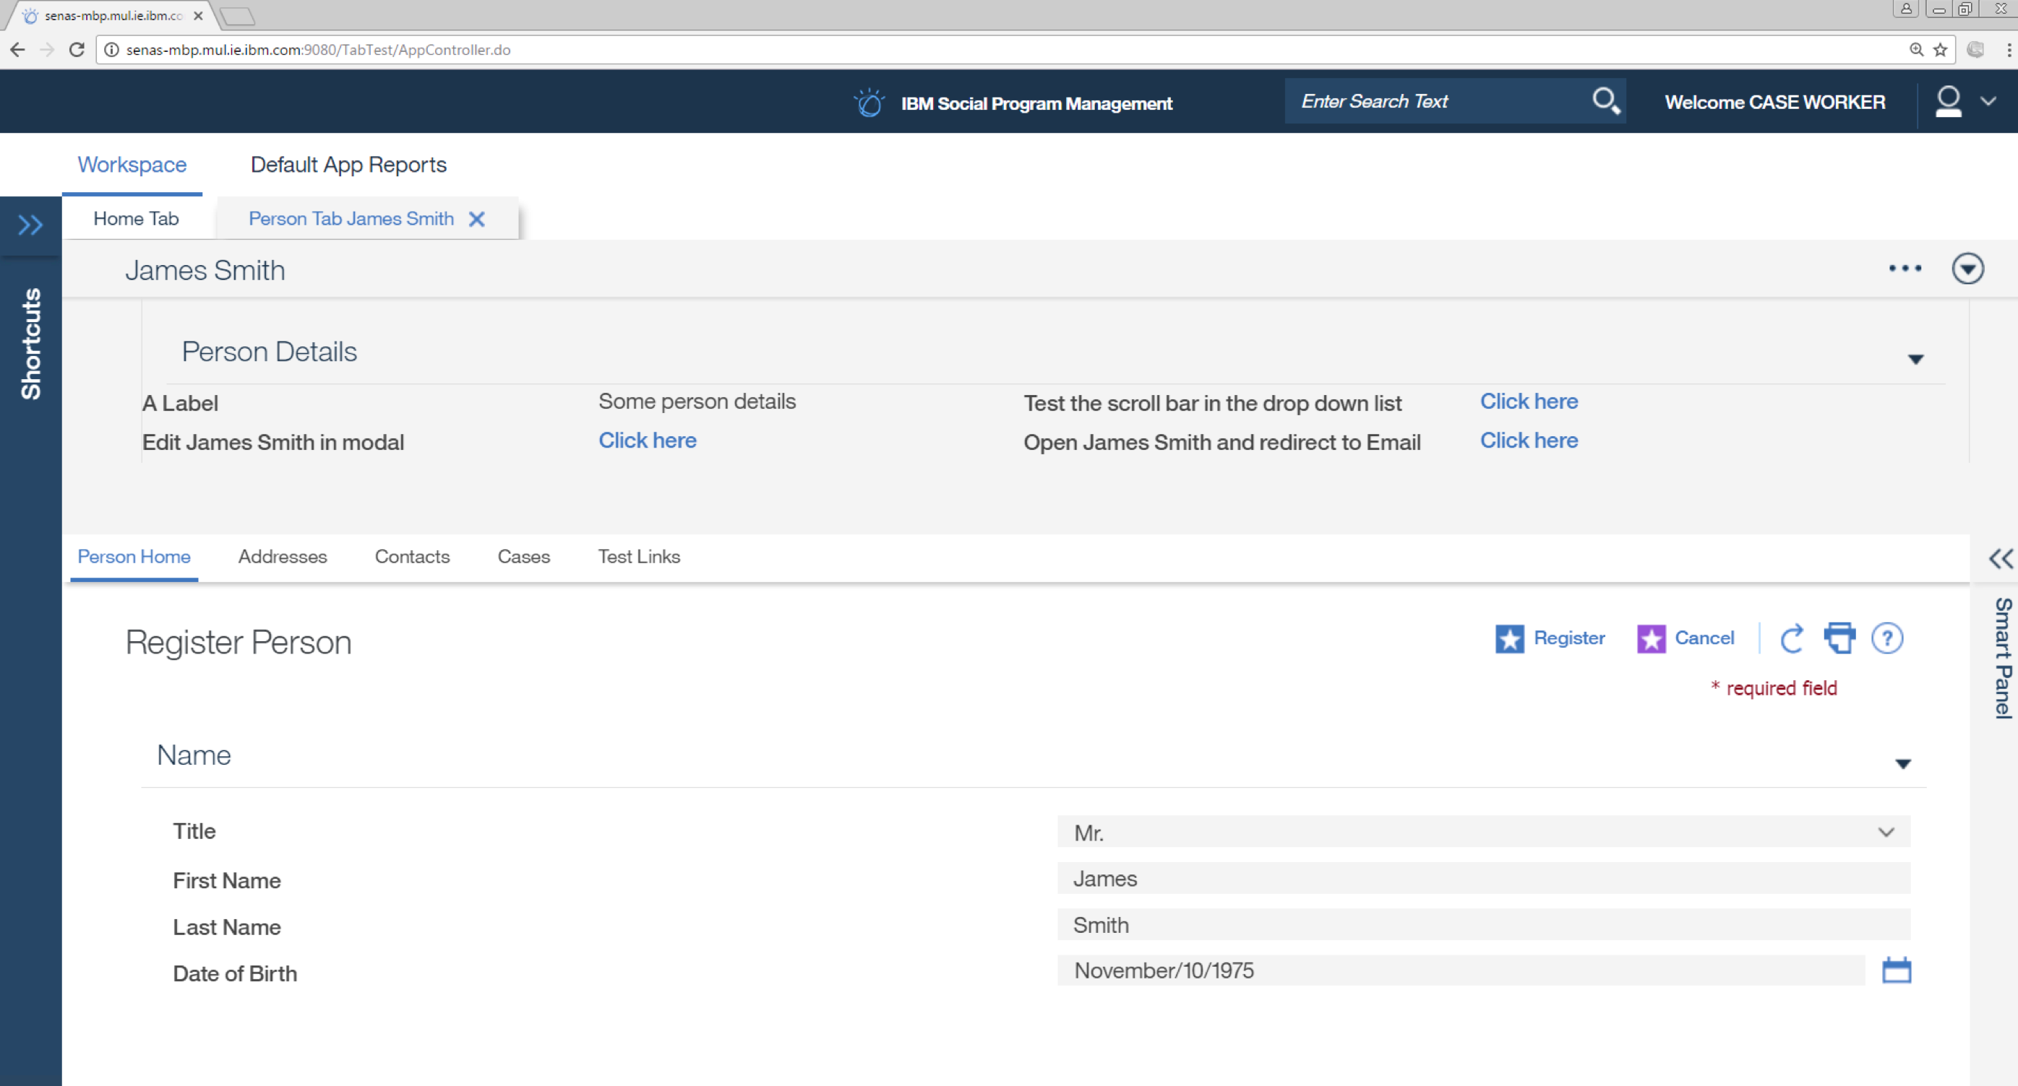
Problem Statement - Person Register Example
A user clicking on the browser back, refresh or close buttons while entering data in Cúram such as registering a person may lead to the loss of data without any warning.

Slide 5
Proposed Business Solution
If a citizen or user clicks any of the browser back, refresh or close buttons while using the Cúram Application, they should be informed by means of a dialog displayed by the browser informing them of possible data loss if they proceed.
The citizen or user must be able to return to the page they were on before they clicked any of the browser back, refresh or close buttons so that they can continue with whatever process they had started. E.g. if the user is entering data in a Cúram Application and they inadvertently click one of the browser back, refresh or close buttons, they must be able to return back to where they were without any loss of data.
System behavior on browser back, refresh or close buttons must be consistent across all browsers supported by Cúram.
This feature can be enabled separately for the both the internal and external applications using global system administrator configuration properties

Slide 6
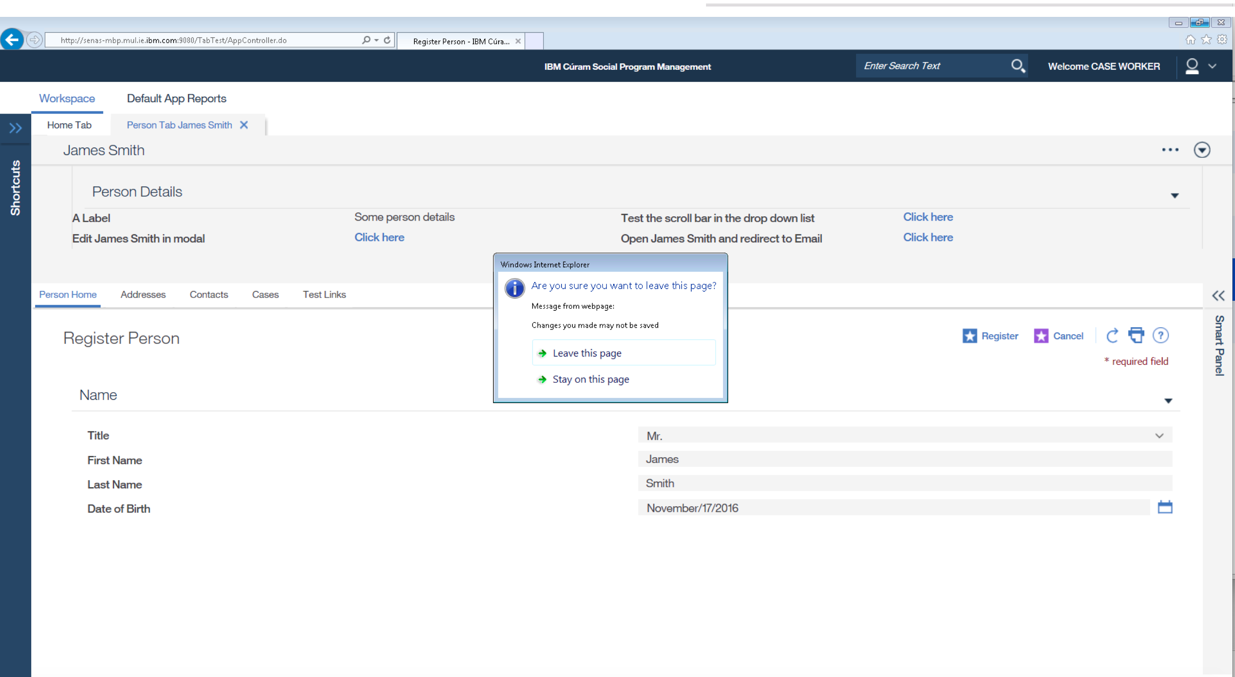
Proposed Business Solution Example - IE11 confirmation dialog

Slide 7
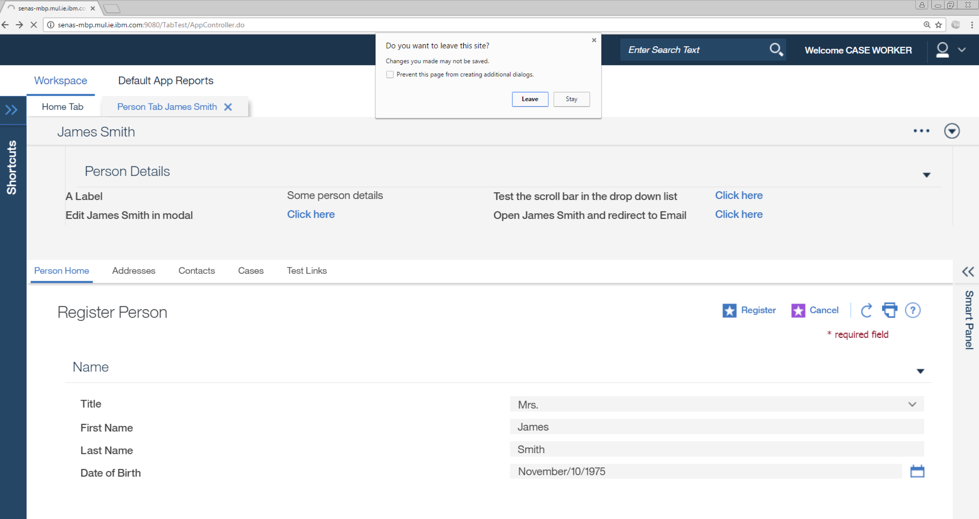
Proposed Business Solution Example - Chrome confirmation dialog

Slide 8
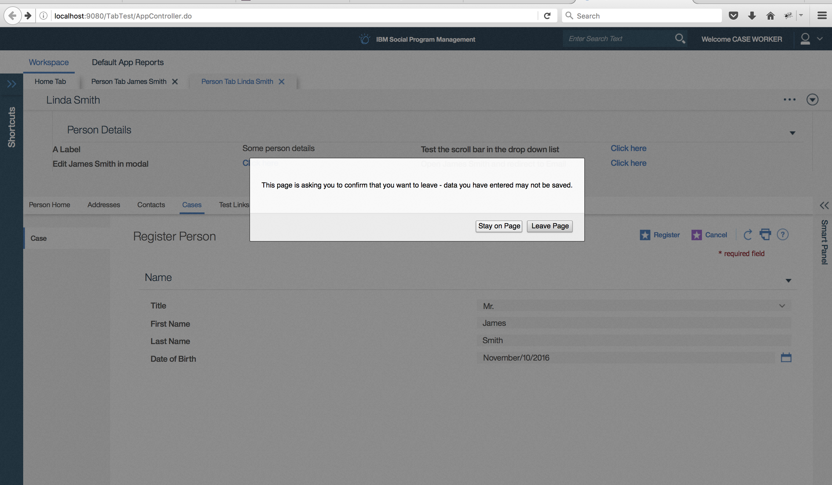
Proposed Business Solution Example - Firefox confirmation dialog

Slide 9
Technical Overview
Implementation
The prevent data loss enhancement will be implemented in the CDEJ infrastructure
Client side details:
Using 'beforeunload' Event
Using the existing module(curam/util/ui/AppExitConfirmation)
Configuration
Activation in external application by setting existing curam.external.app.guard.against.leaving system property to true.
Activation in internal application by setting new curam.internal.app.guard.against.leaving system property to true.

Slide 10
Technical Overview
Reusability
The prevent data loss enhancement is being implemented using an external dojo module in JDE.
Available across all components to implement in IEG, CEF, UA, etc.
Available for customers to implement using the existing dojo module.
Notes:
Is there much work involved in this? is this just a documentation task for us to tell what to do?

Slide 11
Delivery Timelines
Area | User Stories | Sprint Delivery | Stack Delivery
JDE | Disallow dialog on Logout Add a message to inform a user that the action they have performed may result in loss of data. | 7.0.1.0 7.0.1.0 | JDE Stack 1

Slide 12

QUESTIONS?

